Slide 1
SSIE 523 Collective Dynamics of Complex Systems
Project Title: Spread of alcoholism in a community.
Monish Raja Senthilkumar
Sabarish Ananthanarayanan
Sai Himalay Nikhil Kondapally
Shantanu Gaurkhede
Sujay Ravi

Slide 2
Agenda
Introduction
Modules/libraries used
Assumptions
Model
Demo
Observations
Future scope

Slide 3
Introduction
We studied the effect of the interactions between people with different drinking habits.
We modeled and analyzed the influence of people’s drinking behaviour in a group.
We also tried to find how the initial condition has influence on the future state of the group.
It is an adaptive and dynamic network model.

Slide 4
Modules/libraries used
The following libraries/modules have been used
-Network-X Module
-Matplotlib
-PYCXsimulator

Slide 5
Assumptions
It is an closed community with 20 people.
Each person has a different characteristics
a) Non-drinkers (Green)
b) Social drinkers ( Blue)
c) Heavy drinkers (Red)
These characteristics are randomly assigned
Each person is connected to random number of neighbour’s.
The strength of influence of the neighbours (shown by weight of Edges )
Strength of influence is assigned a random number ranging between (0-1)

Slide 6
Assumptions continued…
A person under strong influence can change to an other state depending on the type of the influencer.
A non drinker cannot directly change into an addict. He first becomes a social drinker and if the influence continues he changes to heavy drinker and vice versa.
Non drinker
Social drinker
Heavy drinker

Slide 7
Assumptions continued…
There is a certain average resistance for the state to change (threshold).
If the intensity of the influence is exceeding above the resistance then the change of state happens.
A person can get a new neighbour or loose a neighbour randomly.

Slide 8
How the model works?
Initialization
20 nodes (people) are created.
The number of edges (connections) in the entire group is taking a random number between 20 to 50.
Drinking habits are randomly assigned to each node.
Node takes color depending on the type of drinking habit.

Slide 9
How the model works? …
How a person changes his state?
The weight of edges between neighbours of each node is taken.
Weights of same category are summed up.
The summed weight is normalized by dividing it with number of neighbours for the given node.
If max. of normalised weight > threshold then the state changes.

Slide 10
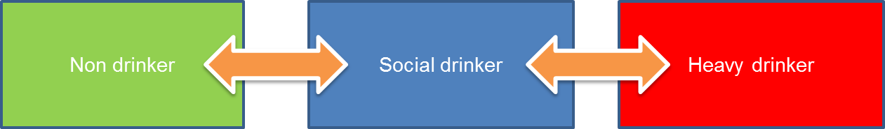
How the model works? …
W1
Total neighbours of node i = 6
W6
W2
Node i
Red normalised weight = (W1+W2)/6
W5
Green normalised weight = (W3+W4)/6
W3
W4
Blue normalised weight = (W5+W6)/6
Max of normalised weight > threshold
Node updates

Slide 11
How the model works? …
Adding and removing edges
Edges are added and removed randomly between 2 random nodes.
It adds or removes edge if it satisfies the condition “if random()>0.8”
The new edges are also given weights which are random too.

Slide 12
Demo

Slide 13
Observation….
If one type of neighbours are in majority initially, they have higher chance of changing the community in their direction.
The end state is always tends to incline towards one kind.
Also as the weights are random, there could be other possibilities too as shown in next slide.

Slide 14
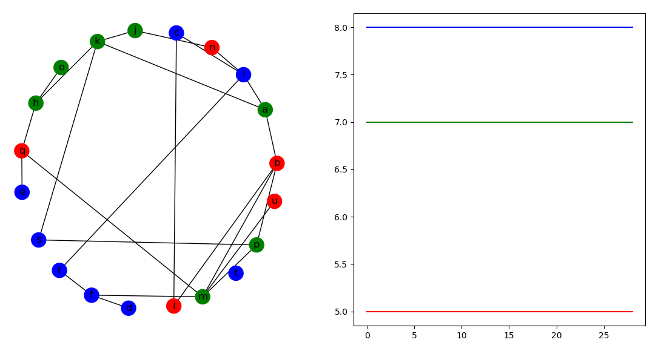
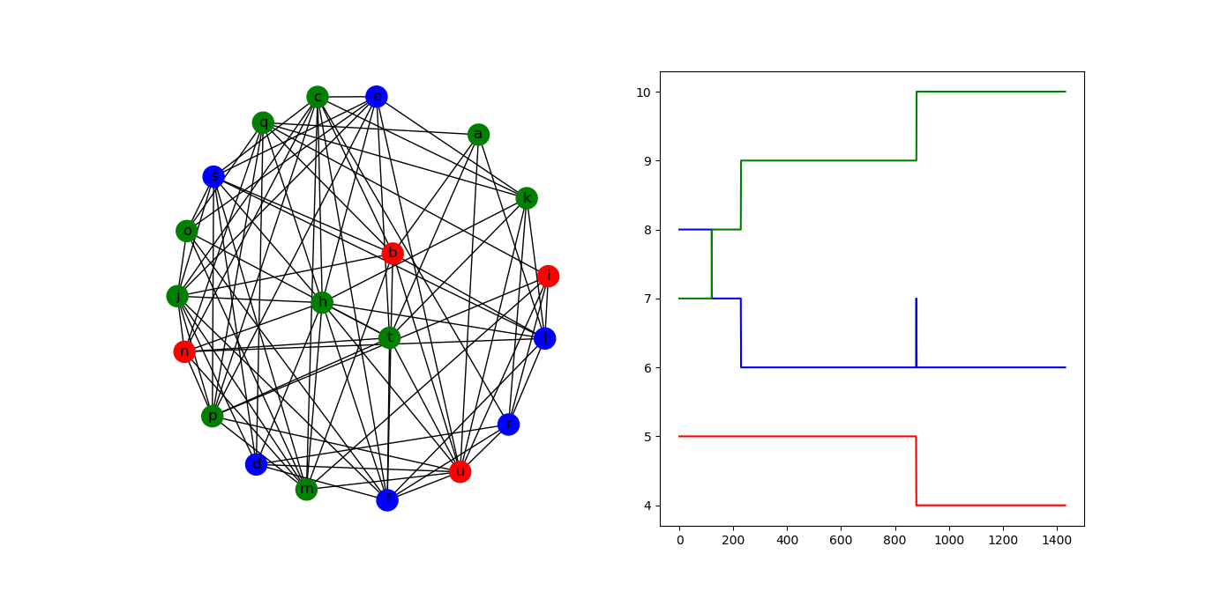
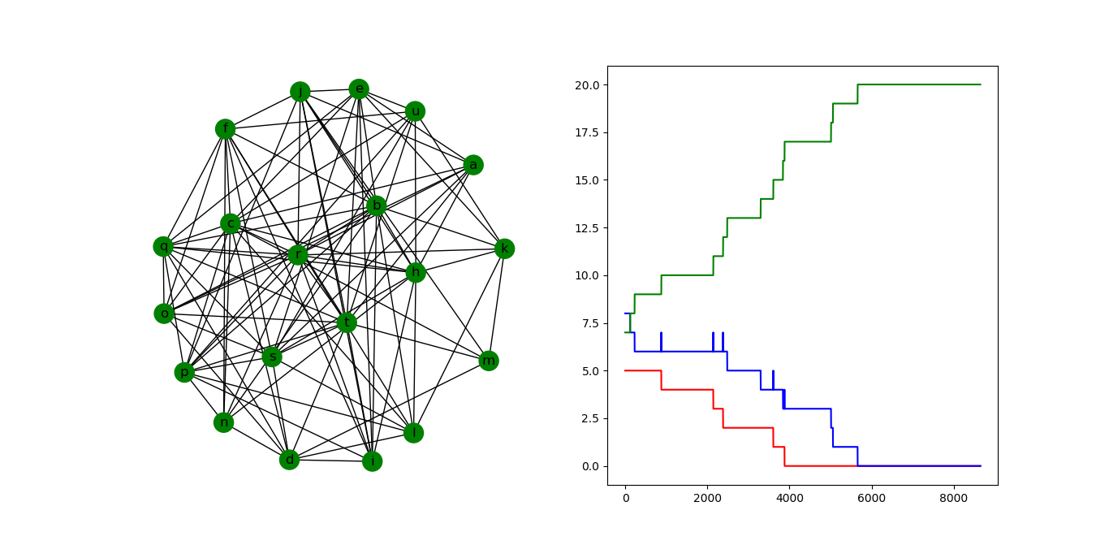
Observations

Slide 15
Future scope
The present model deals with a closed community, in future we can dynamically add and remove nodes (people).
The resistance to change state is taken as a single threshold value for the entire group, in future we can add resistance to change for every node to get more insight.

Slide 16
Thank you !

Slide 17
Any Queries???

